Slide 1
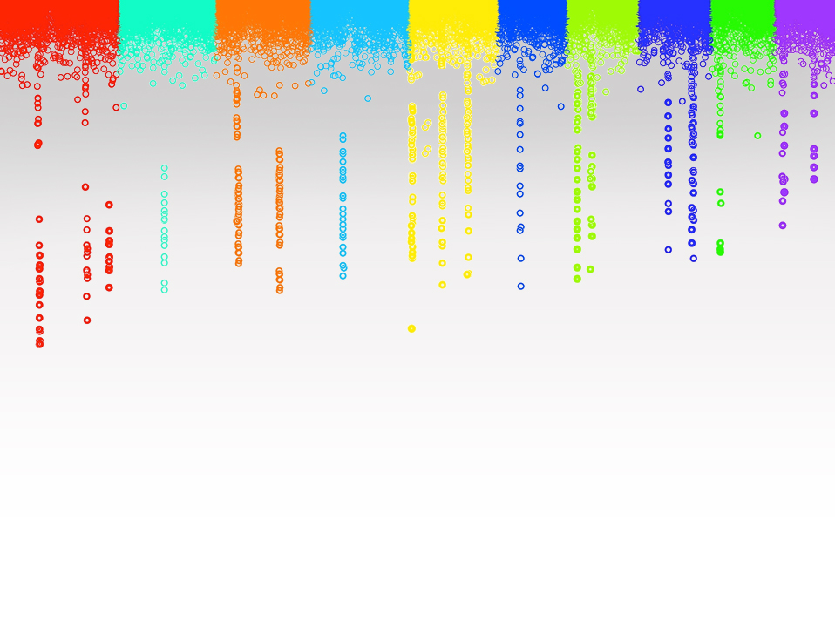

Statistical Genomics
Lecture 30: Machine Learning
Zhiwu Zhang
Washington State University

Slide 2
Administration
Final exam: May 4 (Friday), 120 minutes (3:10-5:10PM), 50 questions, 272 Johnson
Party: May 4, Friday, 5:30-7:30, 272 Johnson
Course evaluation response: 100% (THANKS)

Slide 3
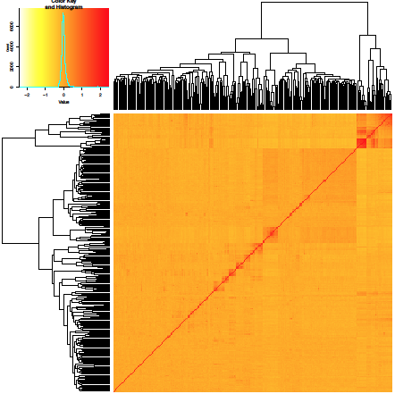
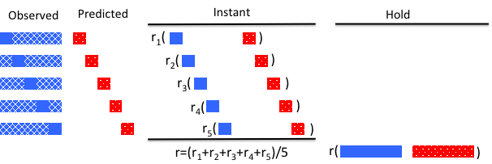
Outline
Machine learning
Kernel method
Data mining

Slide 4
Hard coded multiple players' moves won the champion
1996: Garry Kasparov vs IBM deep blue

Slide 5
Human online game behavior
2016: AlphaGo by Google DeepMind
vs.
Lee Sedol (No2)

Slide 6
Machine learning
Machine learning is a type of artificial intelligence (AI) that provides computers with the ability to learn without being explicitly programmed.

Slide 7
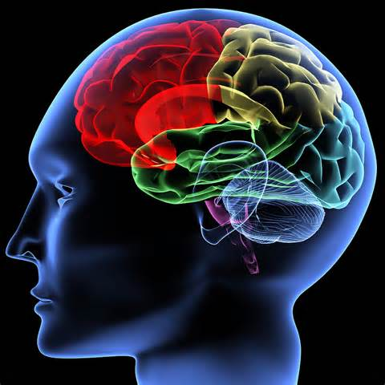

Brain vs. computer
Characteristics
Memory |  | ✔️
Calculation |  | ✔️
Information access |  | ✔️
Life span |  | ✔️
Creative | ✔️

Slide 8
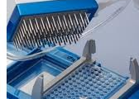
Genome prediction
Based on markers
Based on individuals
Y1, Y2, …, Y_{thousands}
1980~90s
Wang (2017?)
MAS
cBLUP & sBLUP
Y = Xb + Zu
Ridge regression
Bayes (A, B…)
Kinship
_{among individuals}
Ys = S1, + S2, + …, + S _{millions}
Rex Bernardo, gBLUP (1994)
Mewwissen et al,
Genetics, 2001
S1, S2, …, S_{millions}

Slide 9
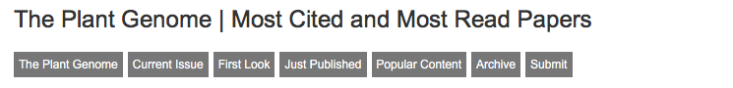
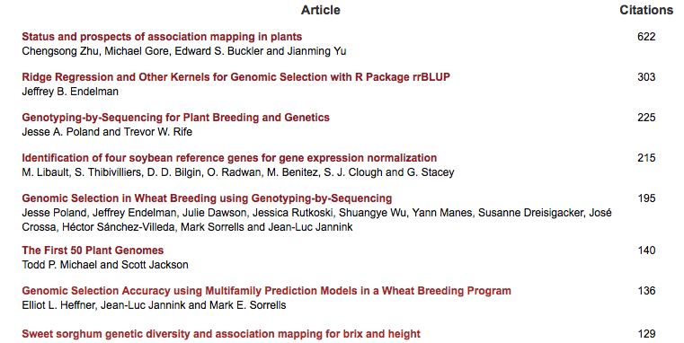

Slide 10
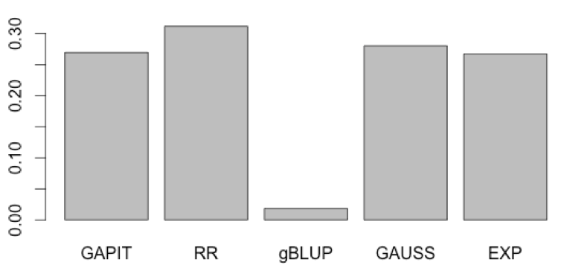
Kernels and Machine Learning
"Kernel method in machine learning: Replacing the inner product in the original (genotype) data with an inner product in a more complex features".
Jeff Endelman (The Plant Genome, 2011)
Divide population into reference and inference
Exam all Kernels
Find the one gives the maximum accuracy in inference

Slide 11
rrBLUP vs. gBLUP
rrBLUP
b~N(0, K σ_{r}²)
y=x₁b₁ + x₂b₂ + … + x_{p}b_{p} + e
gBLUP
~N(0,
σ_{a}²)
U
K

Slide 12

u=Ms
if A=MM$′$
Otherwise, what A should be? can it make a better u?

Slide 13
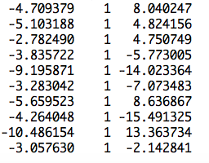
BLUP of individuals
observation
mean
PC2
Ind1 | Ind2 | … | Ind19 | Ind20
u1 | u2 | … | u19 | u20
1 | 0 | … | 0 | 0
0 | 1 | … | 0 | 0
0 | 0 | … | 0 | 0
0 | 0 | … | 0 | 0
u=
]
[
[
b=
b0
b1
]
y
1
x1
x2
=X
Z
[
]
y = Xb + Zu +e

Slide 14
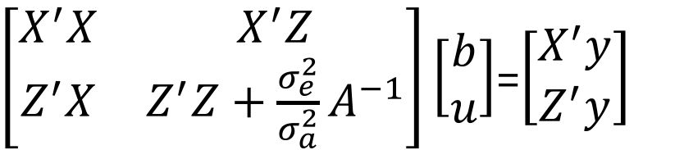
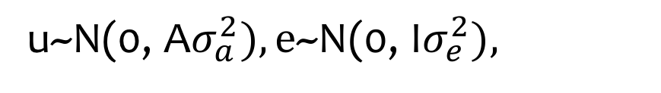
BLUP on individuals
y = Xb + Zu + e
u~N(0, A$σ_{a}^{2}),\text{e}\text{\sim }\text{N}\text{(0,} \text{I}σ_{e}^{2}),$
$\left[\begin{matrix}X^{′}X & X^{′}Z \\ Z^{′}X & Z^{′}Z+{\frac{σ_{e}^{2}}{σ_{a}^{2}}A}^{−1}\end{matrix}\right]\left[\begin{matrix}b \\ u\end{matrix}\right]$=$\left[\begin{matrix}X^{′}y \\ Z^{′}y\end{matrix}\right]$

Slide 15
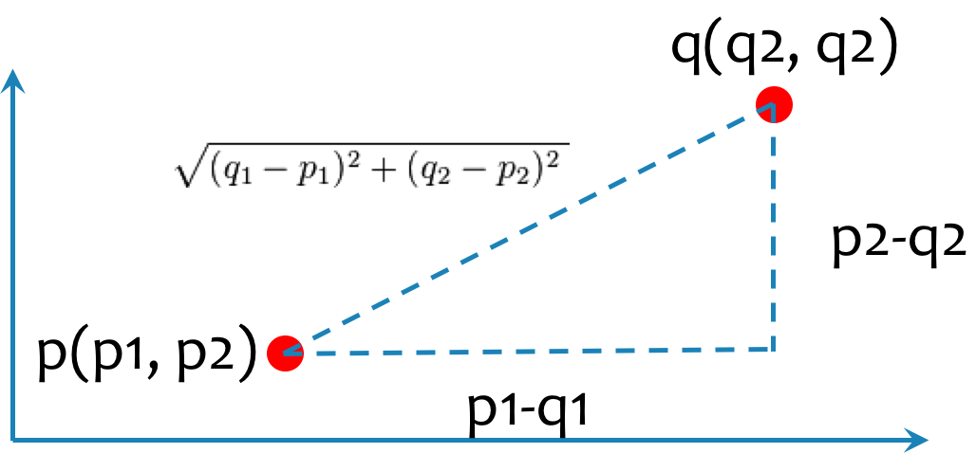
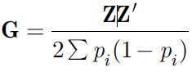
A matrix / Kernel
Twice of Co-Ancestry/kinship
Many formats
Euclidean distance
Nel's distance
VanRaden kinship
ZHANG kinship

Slide 16
SPAGeDi
Hardy OJ, Vekemans X (2002) SPAGeDi: a versatile computer program to analyse spatial
genetic structure at the individual or population levels. Molecular Ecology Notes 2: 618-620.
Kinship coefficient
Loiselle et al. (1995)
Ritland (1996)
Relationship coefficient
Queller & Goodnight (1989)
Hardy & Vekemans (1999)
Lynch & Ritland (1999)
Wang (2002);
Genetic distance: Rousset (2000)

Slide 17
Middle ground
1 | 0 | 0 | 0 | 0
0 | 1 | 0 | 0 | 0
0 | 0 | 1 | 0 | 0
0 | 0 | 0 | 1 | 0
0 | 0 | 0 | 0 | 1
1.00 | 0.05 | 0.05 | 0.06 | 0.04
0.05 | 1.00 | 0.04 | 0.06 | 0.04
0.05 | 0.04 | 1.00 | 0.05 | 0.04
0.06 | 0.06 | 0.05 | 1.00 | 0.05
0.04 | 0.04 | 0.04 | 0.05 | 1.00
1.00 | 0.18 | 0.18 | 0.19 | 0.17
0.18 | 1.00 | 0.17 | 0.18 | 0.16
0.18 | 0.17 | 1.00 | 0.18 | 0.17
0.19 | 0.18 | 0.18 | 1.00 | 0.18
0.17 | 0.16 | 0.17 | 0.18 | 1.00
Ignored
Gauss
Exponancial
gBLUP

Slide 18
Gauss and exponential
G
2 | 0 | 0 | 2 | 2 | 2 | 2 | 2 | 0 | 0
2 | 2 | 0 | 2 | 2 | 2 | 0 | 2 | 0 | 2
2 | 0 | 0 | 2 | 2 | 2 | 0 | 2 | 0 | 0
2 | 2 | 0 | 2 | 2 | 2 | 1 | 2 | 0 | 2
0 | 0 | 0 | 2 | 2 | 2 | 0 | 2 | 0 | 2
D=as.matrix(dist(G, method="euclidean") /2/sqrt(nrow(G)))
method="euclidean", "maximum", "manhattan", "canberra", "binary" or "minkowski"
exp(-(D)^2)
exp(-D)
0.00 | 1.74 | 1.74 | 1.67 | 1.76
1.74 | 0.00 | 1.78 | 1.69 | 1.82
1.74 | 1.78 | 0.00 | 1.71 | 1.80
1.67 | 1.69 | 1.71 | 0.00 | 1.73
1.76 | 1.82 | 1.80 | 1.73 | 0.00
1.00 | 0.05 | 0.05 | 0.06 | 0.04
0.05 | 1.00 | 0.04 | 0.06 | 0.04
0.05 | 0.04 | 1.00 | 0.05 | 0.04
0.06 | 0.06 | 0.05 | 1.00 | 0.05
0.04 | 0.04 | 0.04 | 0.05 | 1.00
1.00 | 0.18 | 0.18 | 0.19 | 0.17
0.18 | 1.00 | 0.17 | 0.18 | 0.16
0.18 | 0.17 | 1.00 | 0.18 | 0.17
0.19 | 0.18 | 0.18 | 1.00 | 0.18
0.17 | 0.16 | 0.17 | 0.18 | 1.00
Gauss
Exponancial

Slide 19
Genetic approach
G
2 | 0 | 0 | 2 | 2 | 2 | 2 | 2 | 0 | 0
2 | 2 | 0 | 2 | 2 | 2 | 0 | 2 | 0 | 2
2 | 0 | 0 | 2 | 2 | 2 | 0 | 2 | 0 | 0
2 | 2 | 0 | 2 | 2 | 2 | 1 | 2 | 0 | 2
0 | 0 | 0 | 2 | 2 | 2 | 0 | 2 | 0 | 2
Additive
K_{A}
K_{AA}=K_{A}K_{A}
0 | 0 | 0 | 0 | 0 | 0 | 0 | 0 | 0 | 0
0 | 0 | 0 | 0 | 0 | 0 | 0 | 0 | 0 | 0
0 | 0 | 0 | 0 | 0 | 0 | 0 | 0 | 0 | 0
0 | 0 | 0 | 0 | 0 | 0 | 1 | 0 | 0 | 0
0 | 0 | 0 | 0 | 0 | 0 | 0 | 0 | 0 | 0
Dominant
K_{D}
K_{DD}=K_{D}K_{D}
K_{AD}=K_{A}K_{D}

Slide 20
Setup GAPIT
#Import GAPIT
#source("http://www.bioconductor.org/biocLite.R")
#biocLite("multtest")
#install.packages("EMMREML")
#install.packages("gplots")
#install.packages("scatterplot3d")
library('MASS') # required for ginv
library(multtest)
library(gplots)
library(compiler) #required for cmpfun
library("scatterplot3d")
library("EMMREML")
source("http://www.zzlab.net/GAPIT/emma.txt")
source("http://www.zzlab.net/GAPIT/gapit_functions.txt")

Slide 21
Import data and preparation
#Import demo data
myGD=read.table(file="http://zzlab.net/GAPIT/data/mdp_numeric.txt",head=T)
myGM=read.table(file="http://zzlab.net/GAPIT/data/mdp_SNP_information.txt",head=T)
myCV=read.table(file="http://zzlab.net/GAPIT/data/mdp_env.txt",head=T)
X=myGD[,-1]
M=as.matrix(X)
G=M
dom=1-(G-1)^2
taxa=myGD[,1]
myDom=cbind(as.data.frame(taxa),as.data.frame(dom))

Slide 22
Phenotype simulation
index1to5=myGM[,2]<6
X1to5 = X[,index1to5]
X1to5.dom = dom[,index1to5]
GD.candidate=cbind(as.data.frame(taxa),X1to5)
GD.candidate.dom=cbind(as.data.frame(taxa),X1to5.dom)
set.seed(99164)
mySim=GAPIT.Phenotype.Simulation(GD=GD.candidate,GM=myGM[index1to5,], h2=.5,NQTN=20, effectunit =.95,QTNDist="normal", CV=myCV,cveff=c(.1,.1),a2=.5,adim=3,category=1,r=.4)
mySim.dom=GAPIT.Phenotype.Simulation(GD=GD.candidate.dom,GM=myGM[index1to5,],h2=.5,NQTN=20, effectunit=.95,QTNDist="normal", CV=myCV,cveff=c(.1,.1),a2=.5,adim=3,category=1,r=.4)
myYad <- mySim$Y
myYad[,2]=myYad[,2]+mySim.dom$Y[,2]
myUad=mySim$u+mySim.dom$u

Slide 23
Validation
set.seed(99164)
n=nrow(mySim$Y)
pred=sample(n,round(n/5),replace=F)
train=-pred

Slide 24
GAPIT
myY=mySim$Y
y <- mySim$Y[,2]
setwd("~/Desktop/temp")
myGAPIT <- GAPIT(
Y=myY[train,],
GD=myGD,
GM=myGM,
PCA.total=3,
CV=myCV,
#KI=K.GAPIT,
KI=cbind(as.data.frame(taxa),as.data.frame(K.AA)), #Comment out for the 1st run
group.from=1000,
group.to=1000,
group.by=10,
QTN.position=mySim$QTN.position,
SNP.test=FALSE,
memo="binary2")
order.raw=match(taxa,myGAPIT$Pred[,1])
pcEnv=cbind(myGAPIT$PCA[,-1],myCV[,-1])
cor(myGAPIT$Pred[order.raw,5][pred],mySim$u[pred])

Slide 25
Kernels
#Import rrBLUP
#install.packages("rrBLUP")
library(rrBLUP)
K.GAPIT=myGAPIT$kinship
K.RR=A.mat(G)
D <- as.matrix(dist(G,method="euclidean")/2/sqrt(nrow(G)))
#option: "euclidean", "maximum", "manhattan", "canberra", "binary" or "minkowski"
K.EXP <- exp(-D)
K.GAUSS <- exp(-(D)^2)
K.AA=K.RR%*%K.RR
K.Dom=A.mat(dom)
K.DD=K.Dom%*%K.Dom
K.AD=K.RR+K.Dom

Slide 26
Using different kinship in GAPIT
Kinship | R
GAPIT | 0.3036
RR | 0.274
EXP | 0.2442
GAUSS | 0.1771
AA | 0.2445
D | 0.0421
DD | 0.1684
AD | 0.0935

Slide 27
Using rrBLUP
ans.RR <- mixed.solve(y=y[train],Z=M[train,],X=pcEnv[train,])
cor(M[pred,]%*%ans.RR$u, mySim$u[pred])
#RegularK
ans.RR<-kinship.BLUP(y=y[train], G.train=G[train,],G.pred=G[pred,], K.method="RR",
X=pcEnv[train,])
cor(ans.RR$g.pred,mySim$u[pred])
#GAUSS
ans.GAUSS<-kinship.BLUP(y=y[train], G.train=G[train,],G.pred=G[pred,], K.method="GAUSS", X=pcEnv[train,])
cor(ans.GAUSS$g.pred,mySim$u[pred])
#EXP
ans.EXP<-kinship.BLUP(y=y[train], G.train=G[train,],G.pred=G[pred,], K.method="EXP", X=pcEnv[train,])
cor(ans.EXP$g.pred,mySim$u[pred])

Slide 28
Using different kinship in rrBLUP
Kinship | R
RR | 0.3315
VanRaden | 0.0183
GAUSS | 0.2801
EXP | 0.267

Slide 29
An R function for grouping
cut(1:20, 3, labels=FALSE)
1 1 1 1 1 1 1 2 2 2 2 2 2 3 3 3 3 3 3 3

Slide 30
Cross validation
nrep=30
nfold=5
set.seed(99164)
acc.rep=matrix(NA,nrep,2)
for (rep in 1:nrep){
#setup fold
myCut=cut(1:n,nfold,labels=FALSE)
fold=sample(myCut,n)
for (f in 1:nfold){
print(c(rep,f))
testing=(fold==f)
training=!testing
#GS with RR
ans.RR <- mixed.solve(y=mySim$Y[training,2],Z=M[training,],X=pcEnv[training,])
r.ref=cor(M[training,]%*%ans.RR$u, mySim$u[training])
r.inf=cor(M[testing,]%*%ans.RR$u, mySim$u[testing])
acc=cbind(r.ref, r.inf)
if(f==1){acc.fold=acc}else{acc.fold=acc.fold*((f-1)/(f))+acc*(1/f)}
}#fold
acc.rep[rep,]=acc.fold
}#rep
colMeans(acc.rep)

Slide 31
Accuracy of 30 iterations

Slide 32
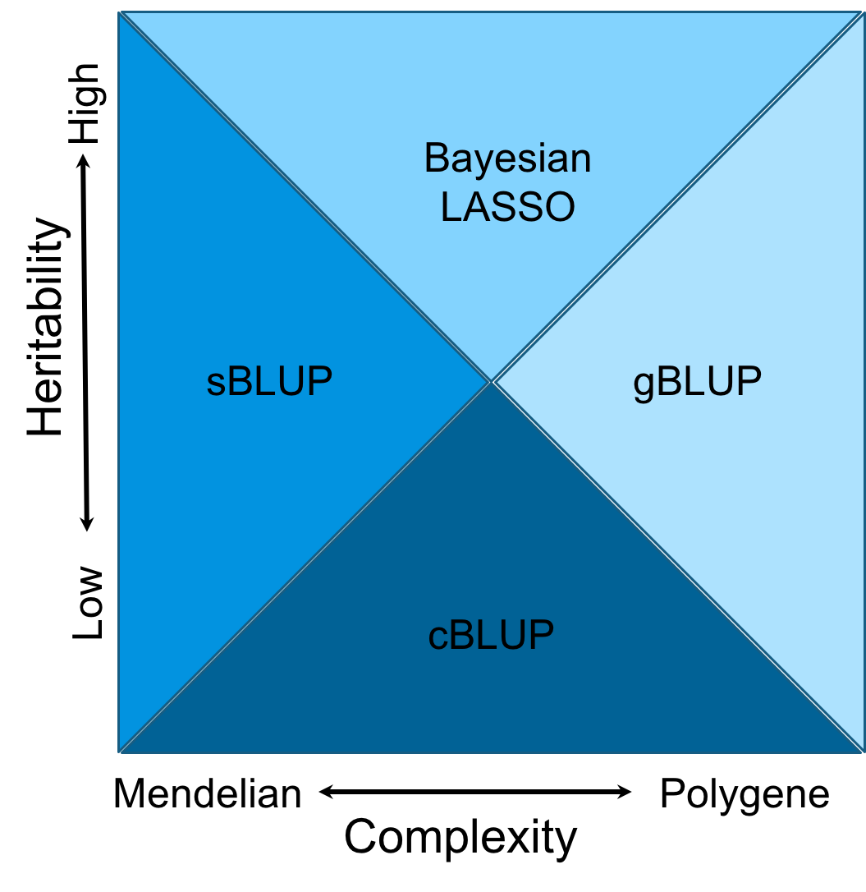
Domains
Notes:
Figure 6.The cost time of computing genomic prediction in three method.
Bayesion method (green) cost most time than other methods, and gBLUP (blue) is the least. The cost time of scBLUP (orange) computing genomic prediction depend on the number of individuals of population (compression) and the number of markers (SUPER). The computing time is calculated by CPU computing time.

Slide 33
Data mining
Knowledge
Data
Prediction

Slide 34
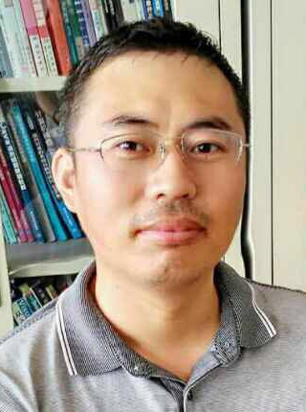
Knowledge and expansion
mMap
…
Data | rrBLUP | gBLUP | cBLUP
Start.Weight | 0.41 | 0.41 | 0.50
FN.Age | 0.57 | 0.58 | 0.74
FN.PctWtLoss | 0.25 | 0.25 | 0.28
FN.postWeight | 0.40 | 0.40 | 0.49
FN.preWeight | 0.39 | 0.39 | 0.49
Weight.Growth Intercept | 0.37 | 0.37 | 0.48
Weight.Growth Slope | 0.31 | 0.32 | 0.34
HTLC | 0.43 | 0.43 | 0.39
BA | 0.49 | 0.49 | 0.47
BD | 0.25 | 0.25 | 0.24
BLC | 0.47 | 0.47 | 0.44
CWAC | 0.45 | 0.44 | 0.43
CWAL | 0.36 | 0.35 | 0.34
DBH | 0.43 | 0.42 | 0.39
HT | 0.36 | 0.35 | 0.34
rootnum | 0.23 | 0.23 | 0.21
rootnumbin | 0.26 | 0.26 | 0.26
gall | 0.23 | 0.22 | 0.22
rustbin | 0.27 | 0.27 | 0.28
c5c6 | 0.26 | 0.25 | 0.23
density | 0.20 | 0.21 | 0.18
lateWood.4 | 0.23 | 0.24 | 0.24
lignin | 0.16 | 0.17 | 0.16
stiffnessTree | 0.37 | 0.38 | 0.37
New data
0.25
0.23
You Tang

Slide 35
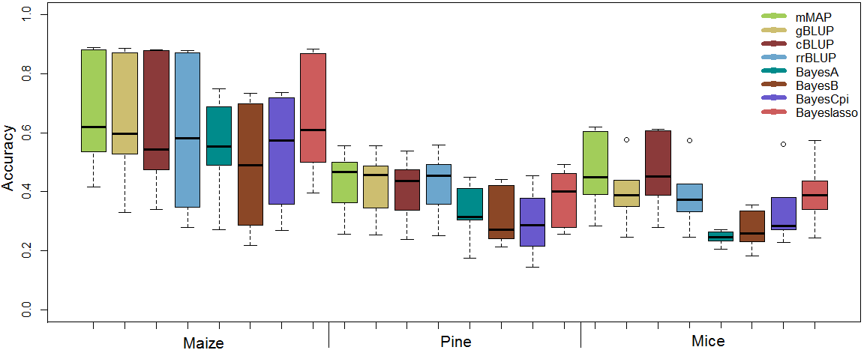
Real traits

Slide 36
Outline
Machine learning
Kernel method
Data mining

Slide 37
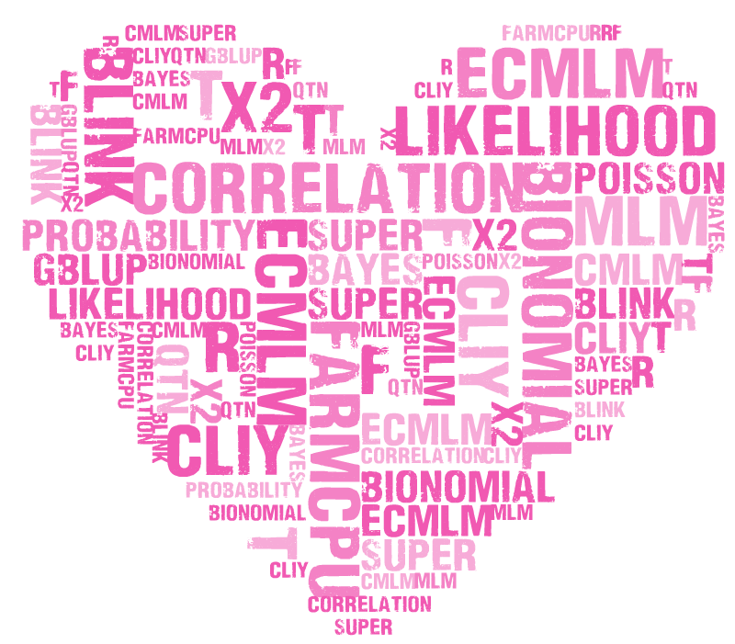
Keywords
MLM cMLM ecMLM SUPER FarmCPU BLINK AlFas correlation QTN gBLUP Bayes likelihood probability R t f x2 MAPCUE Bionomial Poisson distribution statistics phenotype genotype sequencing MAF GAPIT rrBLUP BLR MLMM LASSO Gibbs GateWay PCA Structure Population Kinship OCOTILLO EMMA Matrix inverse Gee!Was.PCA Transpose if loop function type1 error FDR threshold coverage BAGS depth simulation linkage disequilibrium power P3D MAS Cpi A B C Prior Posterior Exponential Kernel Ridge PCAGE

Slide 39
Remains in CROPS 545
Critical thinking
Innovative
Pefection

Slide 40
